Slide 1
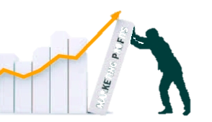
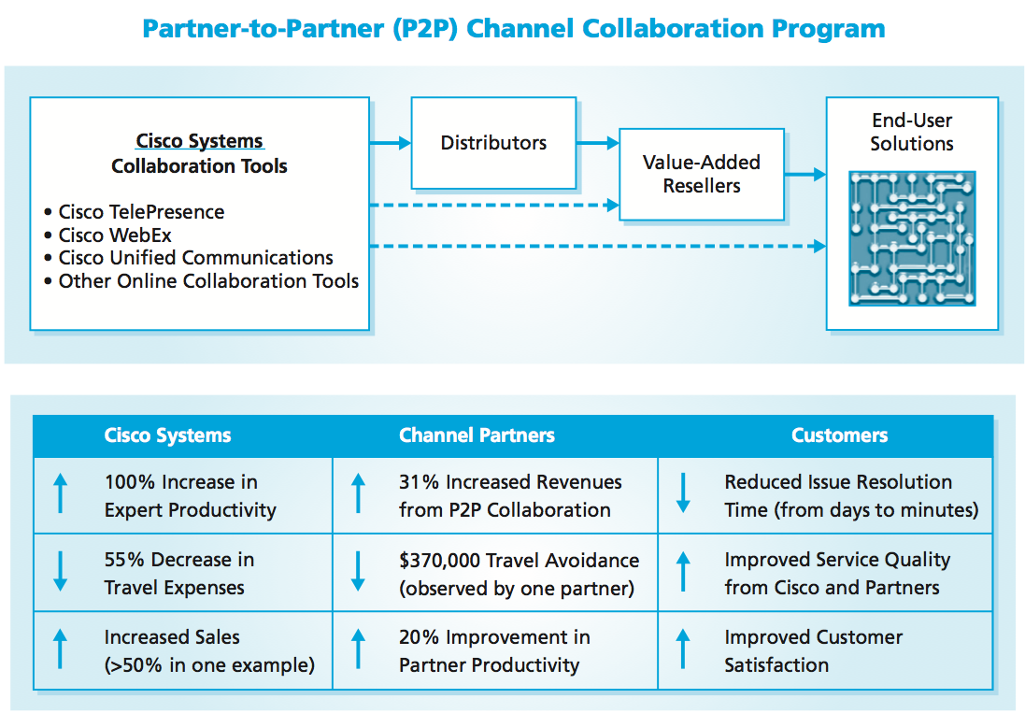
Marketing Channels and Channel Mapping
MBM6
Chapter 9
Chapter 9
Marketing Channels and Channel Mapping
Marketing Channel Performance
Alternative Marketing Channels
Marketing Channels and Competitive Advantage
Marketing channels are the conduits that create customer access to a company’s products.
Copyright Roger J. Best, 2012

Slide 2
Marketing Channels and Channel Mapping
MBM6
Chapter 9
Marketing Channels and Channel Mapping
In this section we will look at how marketing channels are the conduits that create customer access to a company’s products.
Copyright Roger J. Best, 2012

Slide 3
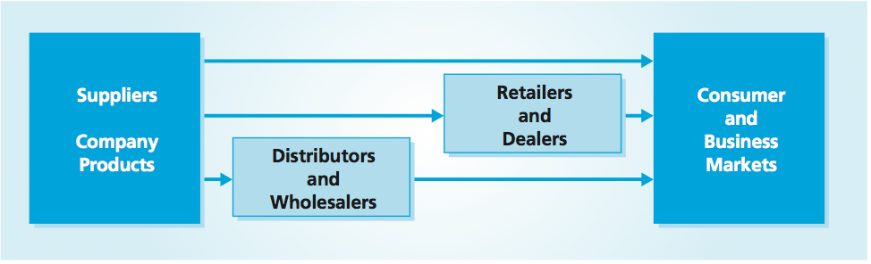
Basic Marketing Channels
MBM6
Chapter 9
Hewlett-Packard sells its products through all the channel paths shown above.
Channel Considerations:
Sales Growth
Profitability
Return on Capital
Brand Leverage
Copyright Roger J. Best, 2012

Slide 4
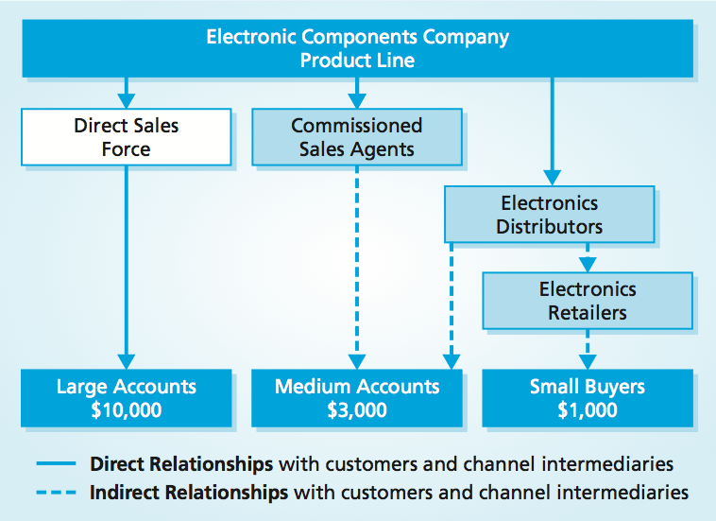
Marketing Performance Tool 9.1
Channel Mapping
MBM6
Chapter 9
This business uses a direct sales force to reach and serve the needs of its large accounts, and uses intermediaries to serve the medium and small accounts
Copyright Roger J. Best, 2012

Slide 5
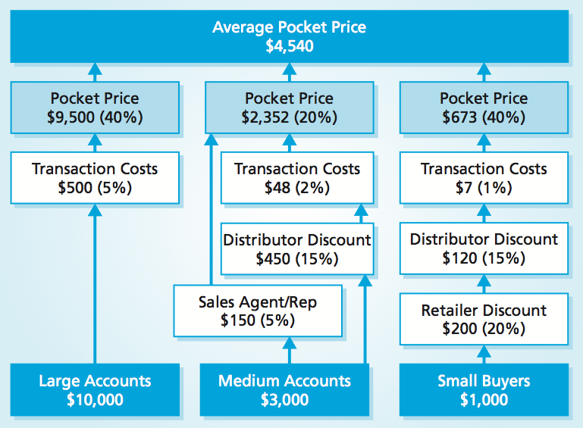
Marketing Performance Tool 9.1
Mapping Channel Pricing and Pocket Price
MBM6
Chapter 9
Each channel to the market produces a different level of sales revenue and has its own set of costs. The channel costs may include discounts to intermediaries, transaction costs, and commissions.
Copyright Roger J. Best, 2012

Slide 6
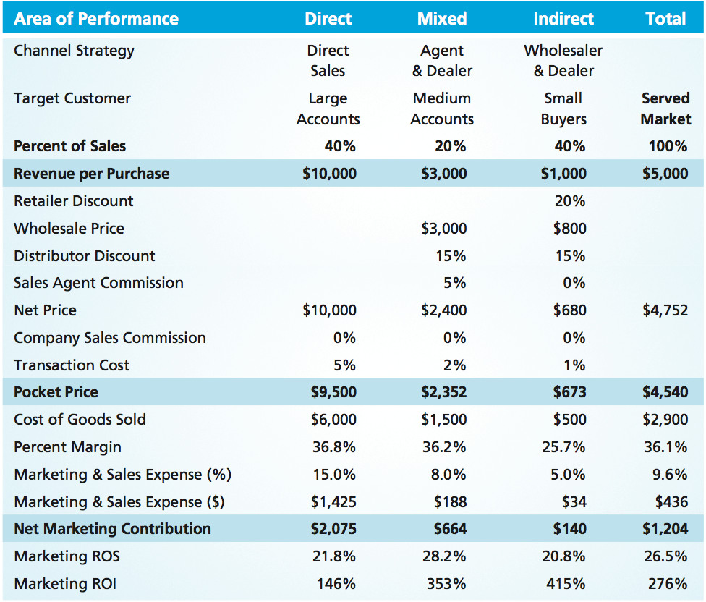
Marketing Performance Tool 9.2
Channel Strategies and Profitability
MBM6
Chapter 9
Why is it so important for a business to understand the pocket price of each channel?
Copyright Roger J. Best, 2012

Slide 7
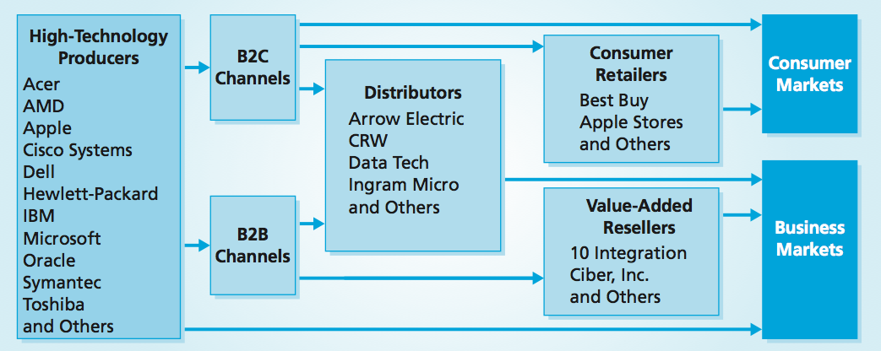
Marketing Channels for High-Tech
MBM6
Chapter 9
Many high-technology manufacturers have a much more complex marketing channel system, due to the need to serve both the consumer market (B2C) and the business market (B2B).
Copyright Roger J. Best, 2012

Slide 8
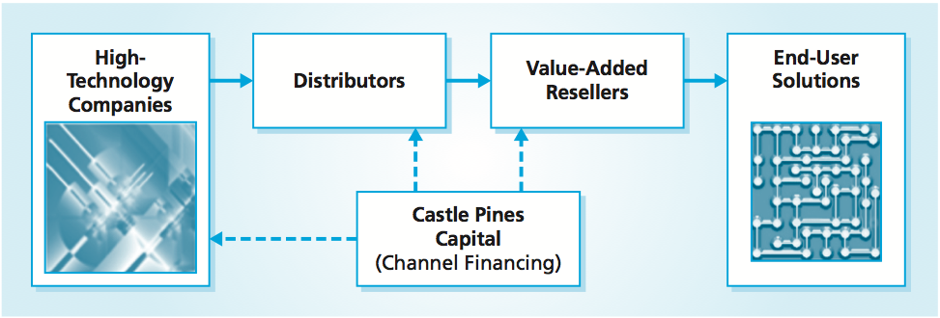
Channel Financing Improves Liquidity
MBM6
Chapter 9
Using a firm like Castle Pines Capital to manage its accounts receivables with distributors, a hi-tech company can allow distributors 60 days to pay their bills while still receiving the payments in 30 days.
Copyright Roger J. Best, 2012

Slide 9
Marketing Channels and Channel Mapping
MBM6
Chapter 9
Marketing Channel Performance
In this section we will look at how channel partners affect marketing channel performance.
Copyright Roger J. Best, 2012

Slide 10
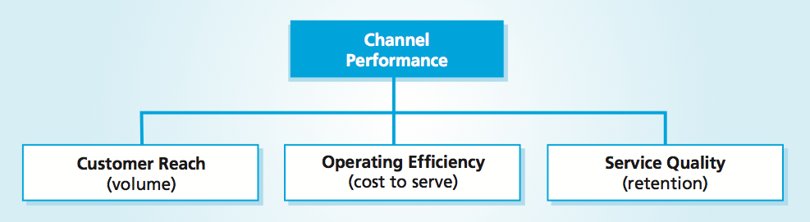


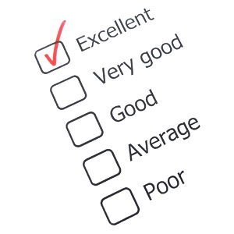
Channel Performance
MBM6
Chapter 9
Copyright Roger J. Best, 2012
Notes:
Marketing channel performance is based on three areas: customer reach, operating efficiency, and service quality. To achieve the desired levels of sales and profits, a channel must do well in all three areas.

Slide 11
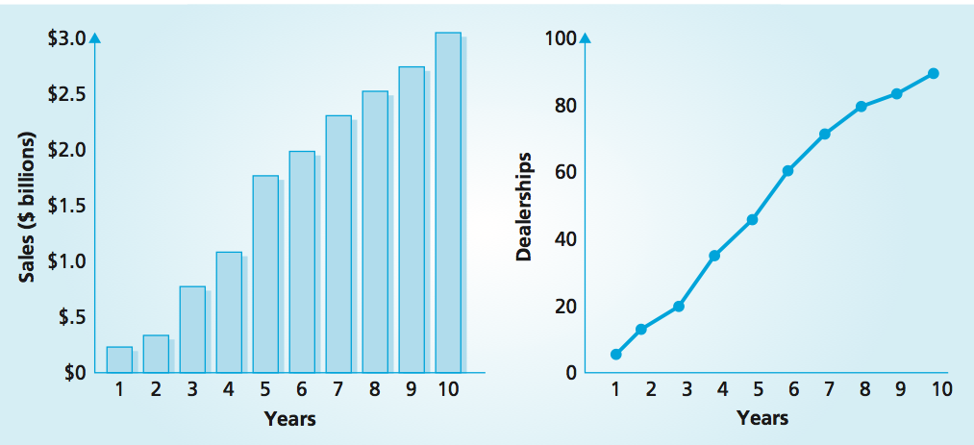
Sales & Channel Customer Reach
MBM6
Chapter 9
The multiple dealerships strategy has allowed this car dealer to become the eighth largest dealer in the U.S.
Copyright Roger J. Best, 2012

Slide 12
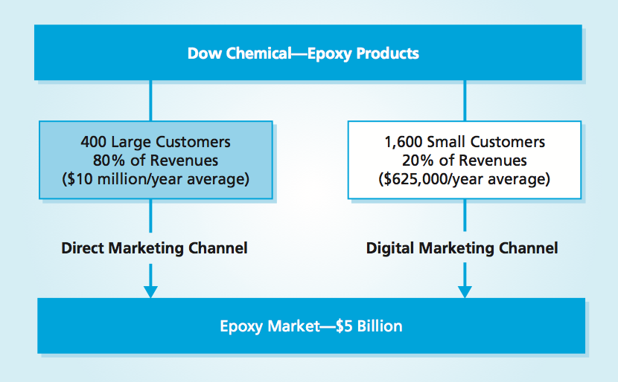
Leveraging Digital Marketing Channels
MBM6
Chapter 9
The ability to reach a world of prospective customers at a low marketing cost has led nearly every business, large and small, to invest in digital marketing.
Copyright Roger J. Best, 2012

Slide 13
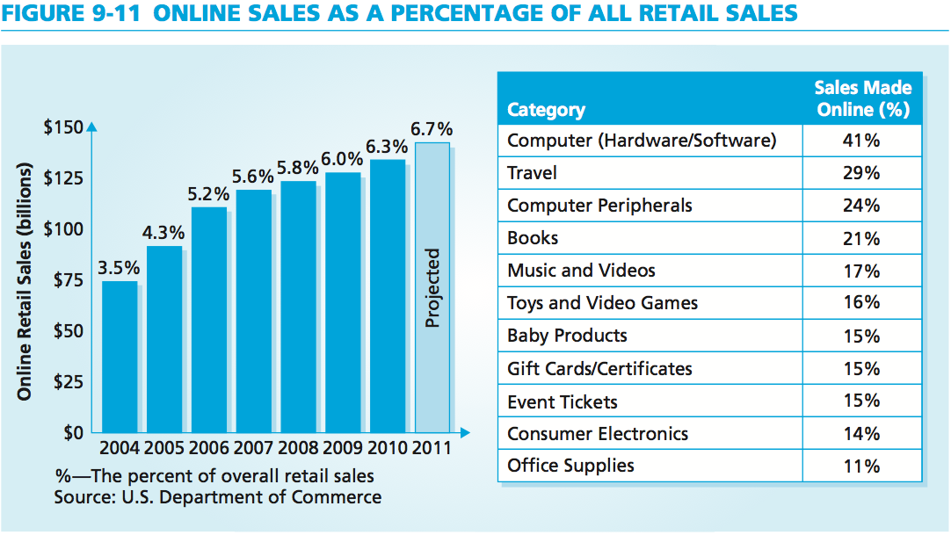
Online Sales Channels
MBM6
Chapter 9
Online sales in the U.S. were $70 billion and 3.5% of retail sales in 2004; grew to $106 billion and 5.2% of retail sales in 2006; and are projected to reach $248.7 billion, about 8% of all retail sales by 2014.
Copyright Roger J. Best, 2012
Notes:
Roughly two of every five purchases of computers and software programs are made online, and about one of every four computer peripherals is bought online.

Slide 14
Marketing Channels and Channel Mapping
MBM6
Chapter 9
Alternative Marketing Channels
In this section we will examine the ways that marketing channels can be configured to reach customers with different needs.
Copyright Roger J. Best, 2012

Slide 15
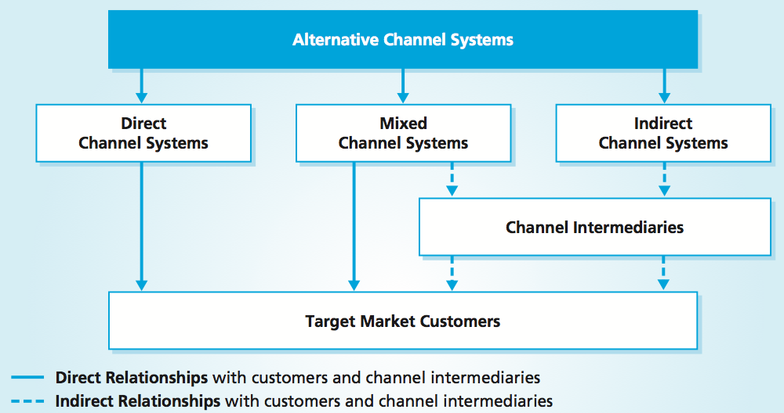
Alternative Channel Systems
MBM6
Chapter 9
Direct Channel Systems: the business retains product ownership until delivery
Indirect Channel Systems: intermediaries take ownership of product
Mixed Channel Systems: utilize a combination of direct and indirect channels
Copyright Roger J. Best, 2012

Slide 16
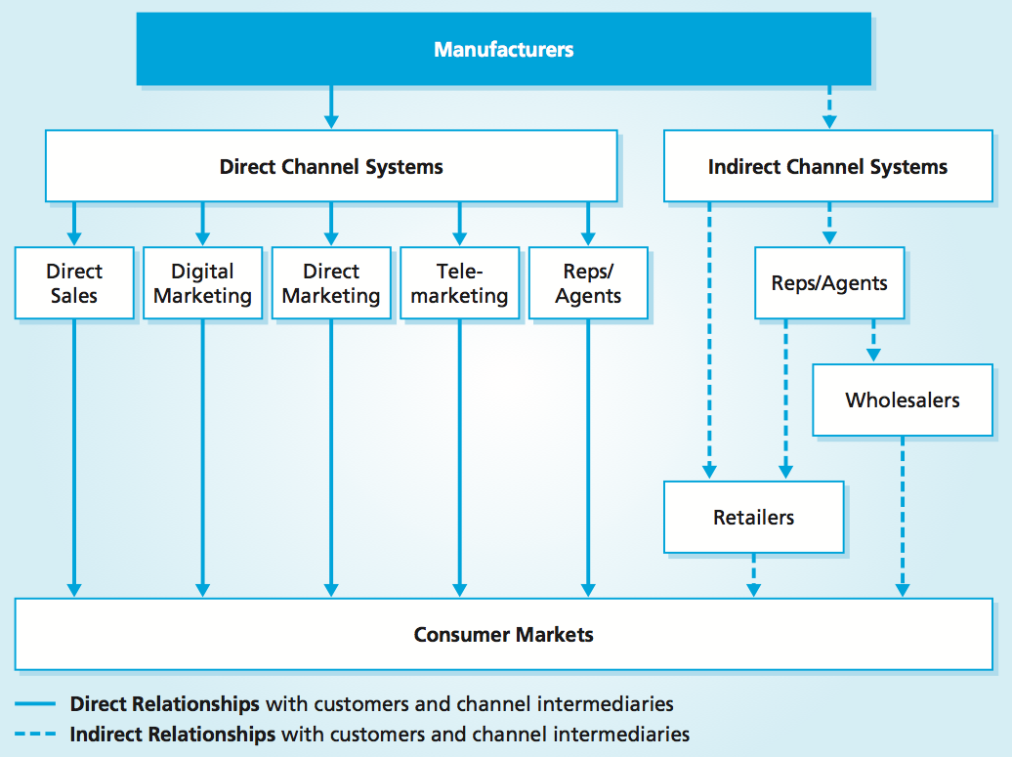
Alternative B2C Marketing Channels
MBM6
Chapter 9
What are the realities of each channel in a B2C space?
Copyright Roger J. Best, 2012

Slide 17
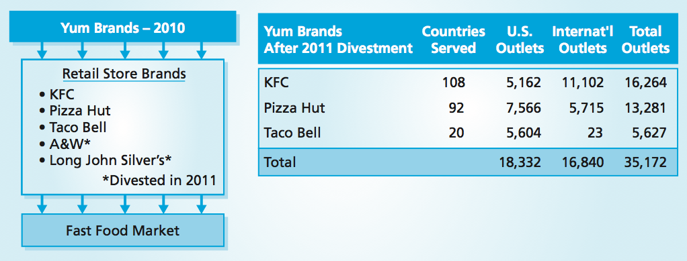
Yum Brands Retail Store Brands
MBM6
Chapter 9
In 2011, Yum Brands announced the sale of A&W and Long John Silver’s. The divestment will enable Yum Brands to sharpen its focus on growing its core brands internationally.
Copyright Roger J. Best, 2012

Slide 18
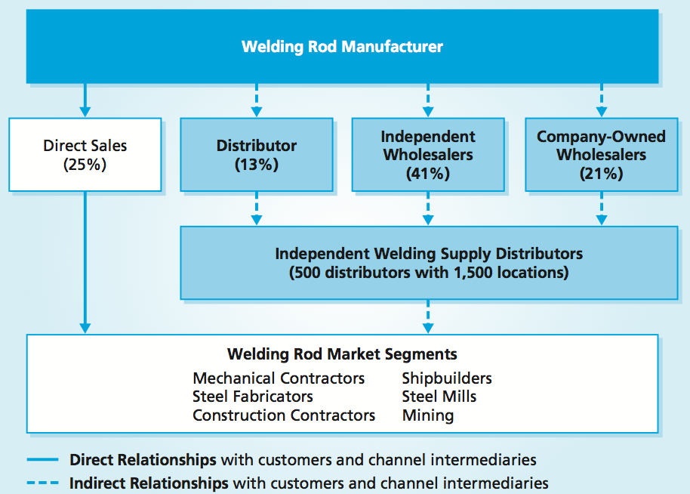
Direct and Indirect Channels
MBM6
Chapter 9
Most businesses would prefer to utilize a direct channel system. However, many manufacturers of industrial and commercial products sell through wholesalers.
Copyright Roger J. Best, 2012

Slide 19
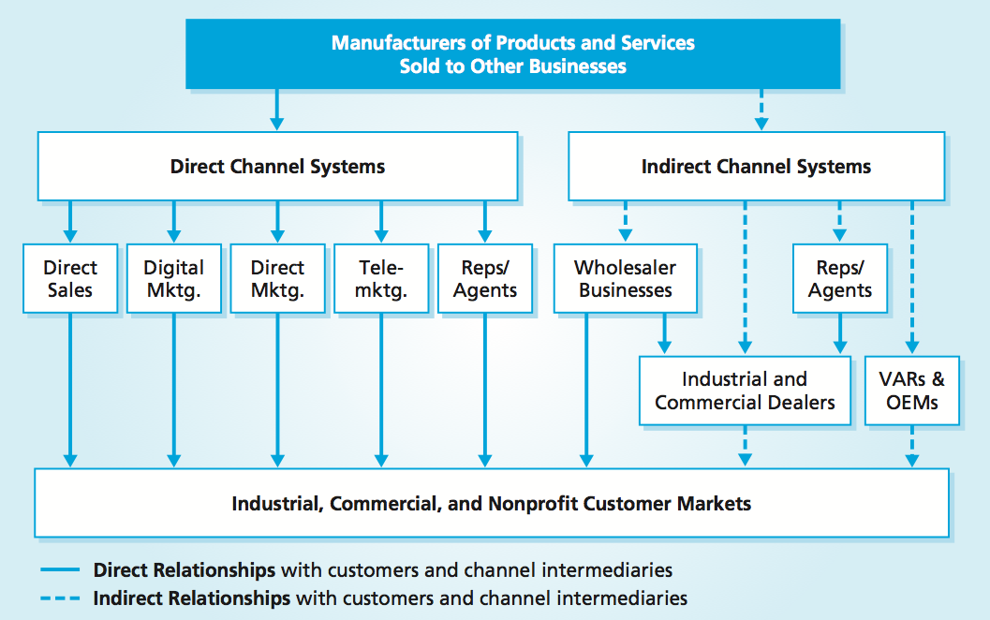
Alternative B2B Marketing Channels
MBM6
Chapter 9
Unique to the business-to-business market are value-added resellers (VARs) and original equipment manufacturers (OEMs).
Copyright Roger J. Best, 2012

Slide 20
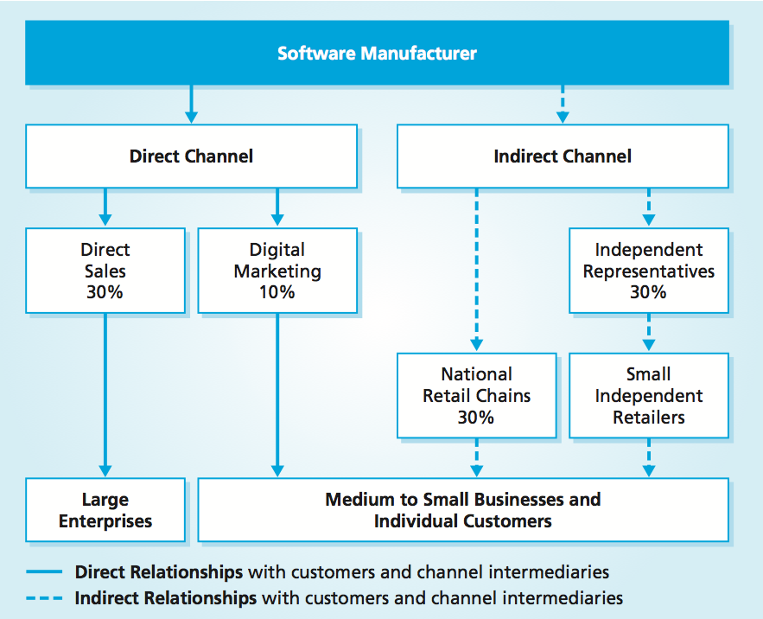
Reaching B2B & B2C Customers
MBM6
Chapter 9
Software manufacturers often use both direct and indirect channels to reach a variety of consumers.
Copyright Roger J. Best, 2012

Slide 21
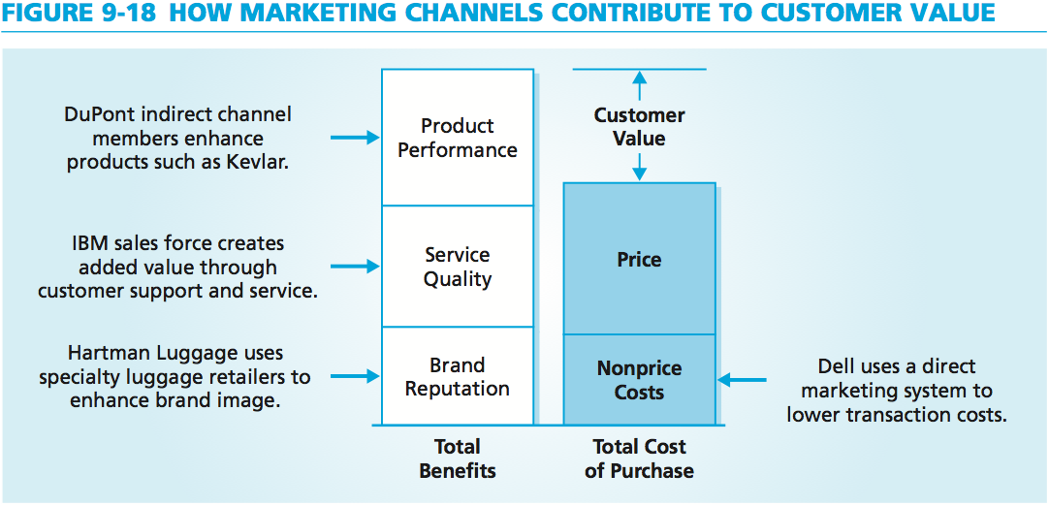
Marketing Channels & Customer Value
MBM6
Chapter 9
To be successful a channel system must enhance customer value by increasing customer benefits, lowering customer cost of purchase, or both.
Copyright Roger J. Best, 2012

Slide 22
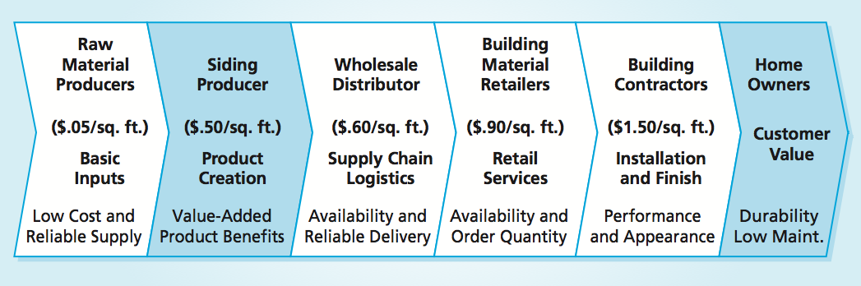
Marketing Channels Add Value
MBM6
Chapter 9
A business must make the product available at the target customer’s desired point of purchase. In addition, it must meet or exceed each of its customer’s product and service requirements, whether the customer is an end user or a channel intermediary.
Copyright Roger J. Best, 2012

Slide 23
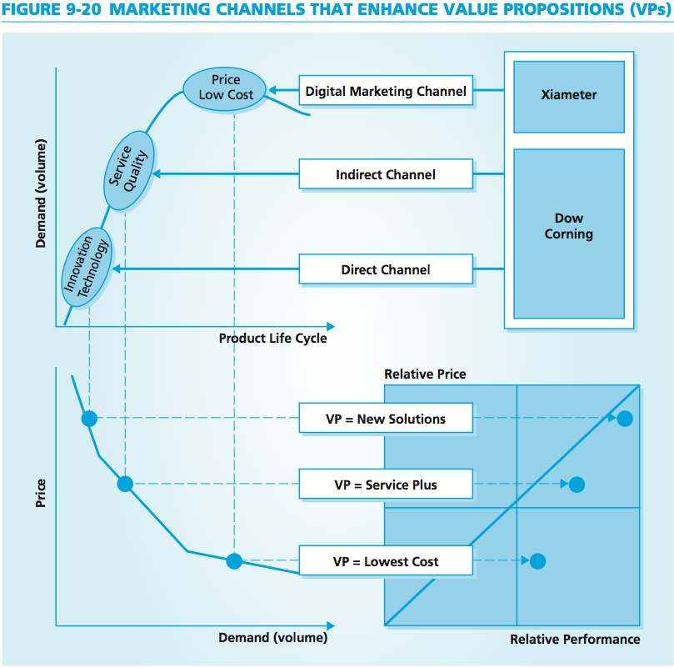
Channels & Value Propositions
MBM6
Chapter 9
Dow’s success with Xiameter is directly linked to its cost-effective digital marketing channel applications for products that are in the mature stage, when prices generally fall.
Copyright Roger J. Best, 2012

Slide 24
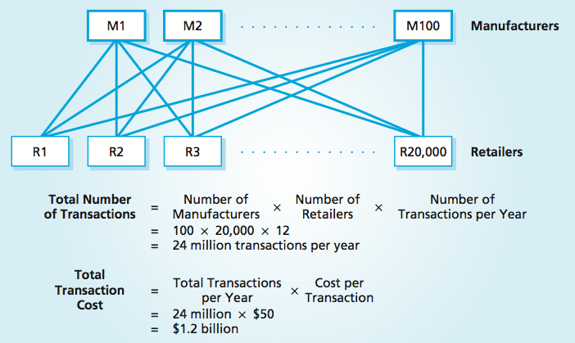
Transaction Costs Without Wholesalers
MBM6
Chapter 9
The more cost-effective a channel system is, the greater the opportunity to lower customer costs or to increase business profitability.
Copyright Roger J. Best, 2012

Slide 25
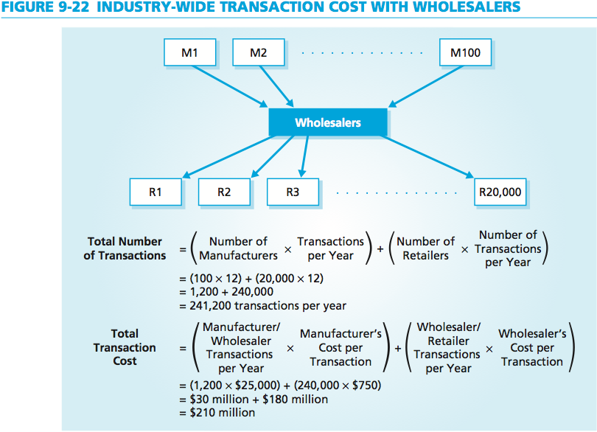
Transaction Costs With Wholesalers
MBM6
Chapter 9
Adding wholesalers to the channel system reduces the total annual transaction costs for the industry by 82.5 percent, to only $210 million.
Copyright Roger J. Best, 2012

Slide 26
Marketing Channels and Channel Mapping
MBM6
Chapter 9
Marketing Channels and Competitive Advantage
In this final section we will briefly explore the ways that marketing channels can serve as a source of competitive advantage.
Copyright Roger J. Best, 2012

Slide 27
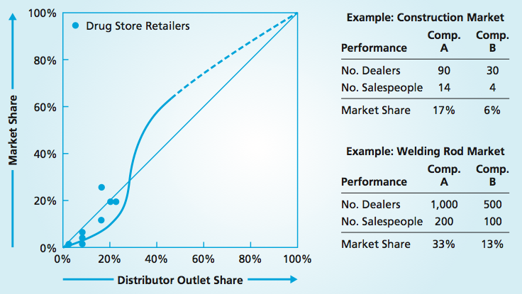
Distribution Share vs. Market Share
MBM6
Chapter 9
For markets dominated by indirect channel systems, share of distributor outlets can be directly linked to market share.
Copyright Roger J. Best, 2012

Slide 28
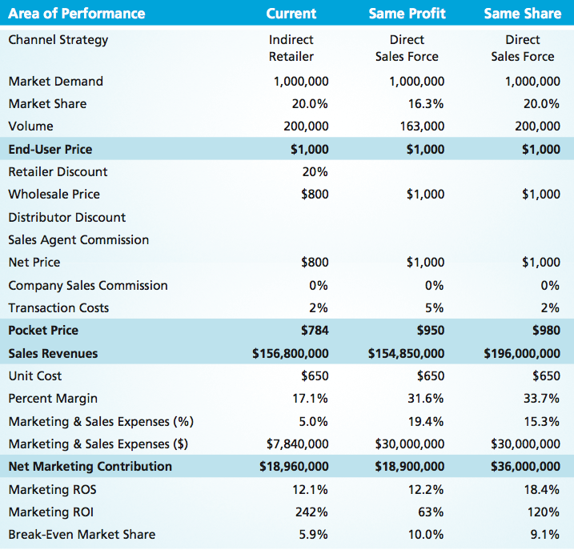
Marketing Performance Tool 9.3
Alternative Channel Marketing
MBM6
Chapter 9
The reach of a marketing channel affects the volume that it produces.
The break-even analysis for each marketing channel strategy provides a way to assess the profitability risk of each channel.
Copyright Roger J. Best, 2012

